Slide 1

Kinect 2.0 Game
Kinect-Breaker

Slide 2
Kinect 2.0 Game
Team members:
G00340314 (John Mannion)
G00340315 (Ray Mannion)
Project Goals:
Create a game using Kinect 2.0 based on the classic Atari game “Super Breakout”.
Player Controls:
The player will use their body movements, moving left or right, to control a game paddle at the bottom of the screen that will use a ball to destroy a set of bricks.

Slide 3
Game Research
Why use the Kinect ?
How to implement the project from start to finish.
The use of the Kinect movement controls.
Working with Unity and Kinect.
Equipment needed to carry out project.

Slide 4
Game Architecture
The game was developed using Unity and Visual Studio. The PC connects to the Kinect 2.0 via windows adaptor.
The game was originally controlled using the arrow keys and having gotten that working the Kinect movement controls were integrated in to the game.
The arrow keys can still be used to play the game as the Kinect controls only activate once the game senses the Kinect has been connected.

Slide 5
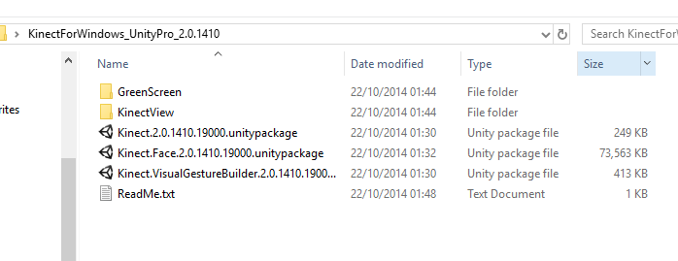
SDK & Unity Plugins
A new (2014) SDK for Kinect v2.
Replaced the previous SDK required for creating projects using the original Kinect.
KinectForWindows_UnityPro_2.0.1410 (plug in)
Only worked with Unity pro until the release of Unity 5

Slide 6
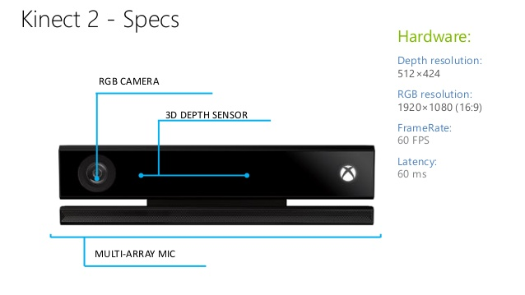
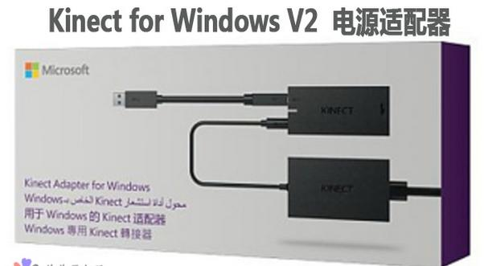
Equipment Required
Kinect V 2.0
Kinect Adaptor for Windows

Slide 7

Installing Kinect on PC
Dedicated USB 3 port
Kinect Studio v2.0
SDK Browser v2.0 (Kinect for windows)
Visual Gesture Builder

Slide 8
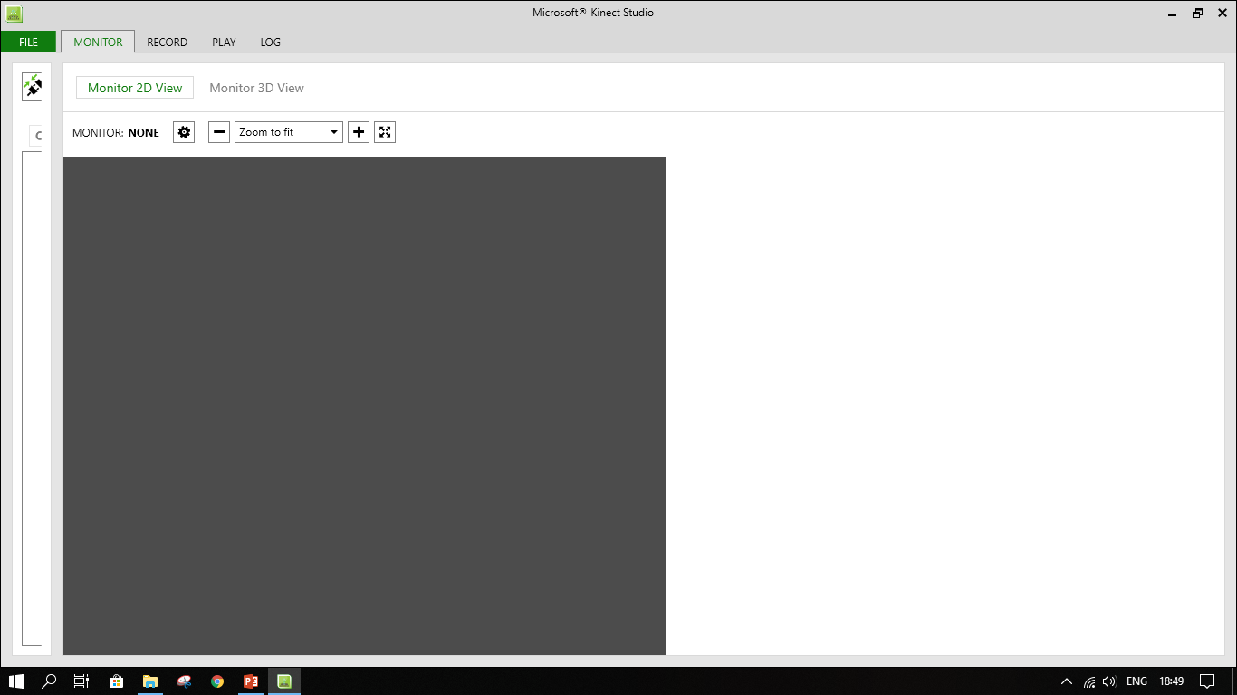
Kinect Studio v2.0

Slide 9
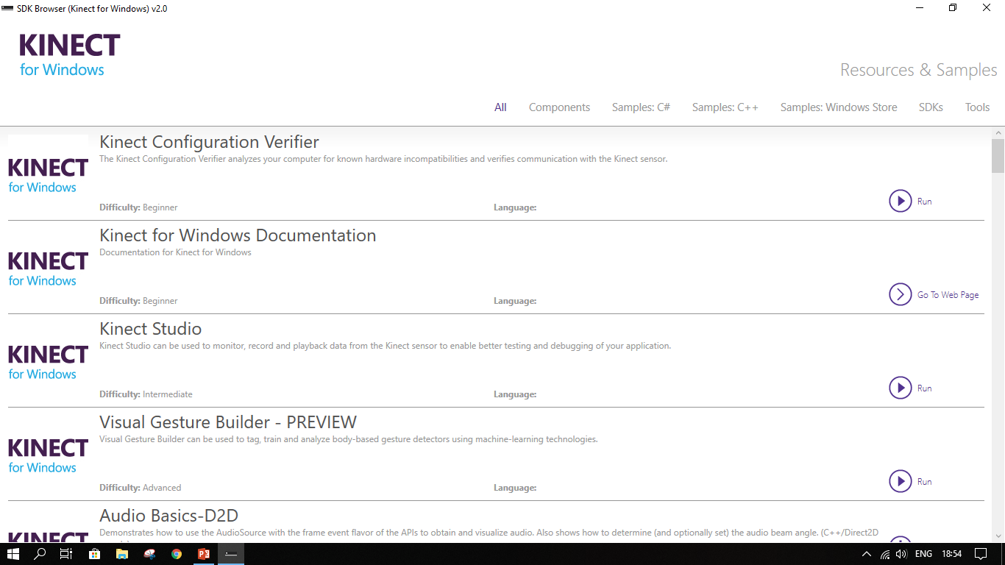
SDK Browser v2.0

Slide 10
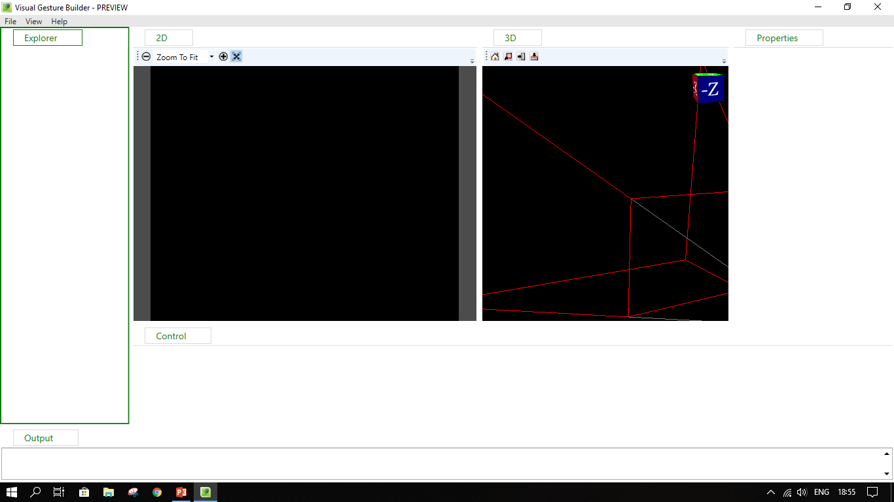
Visual Gesture Builder

Slide 11
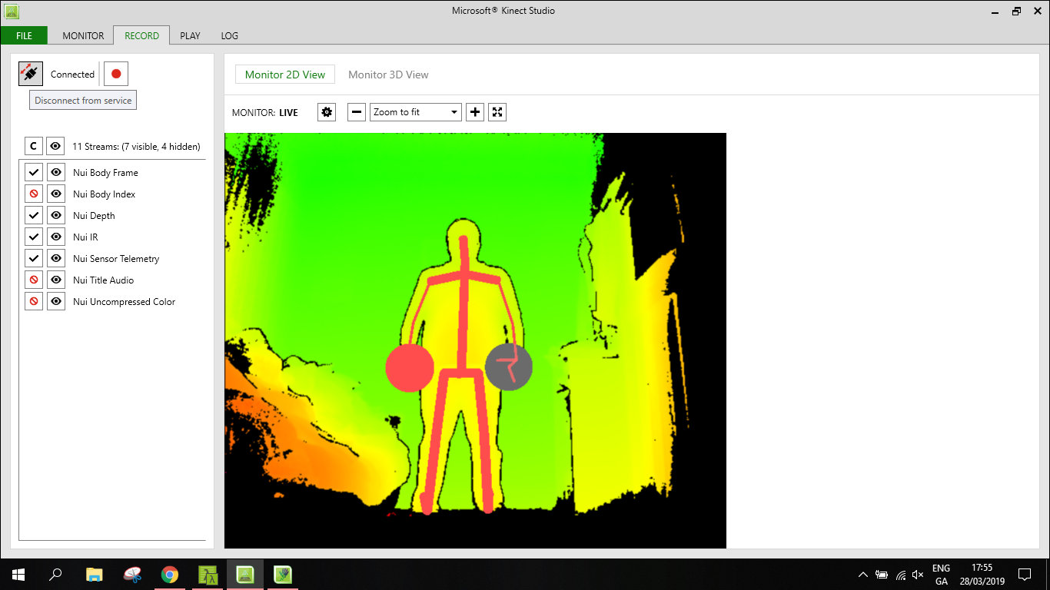
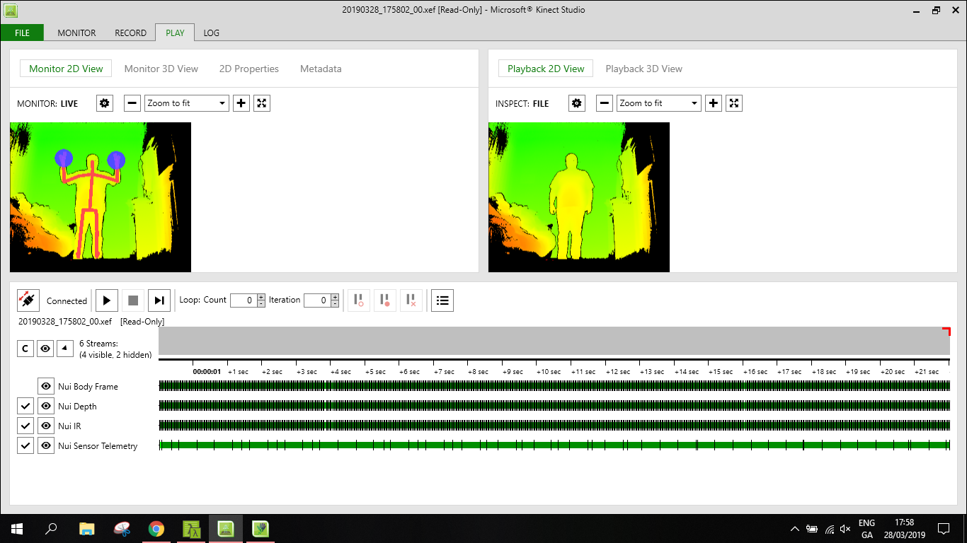
Recording Custom Gestures

Slide 12
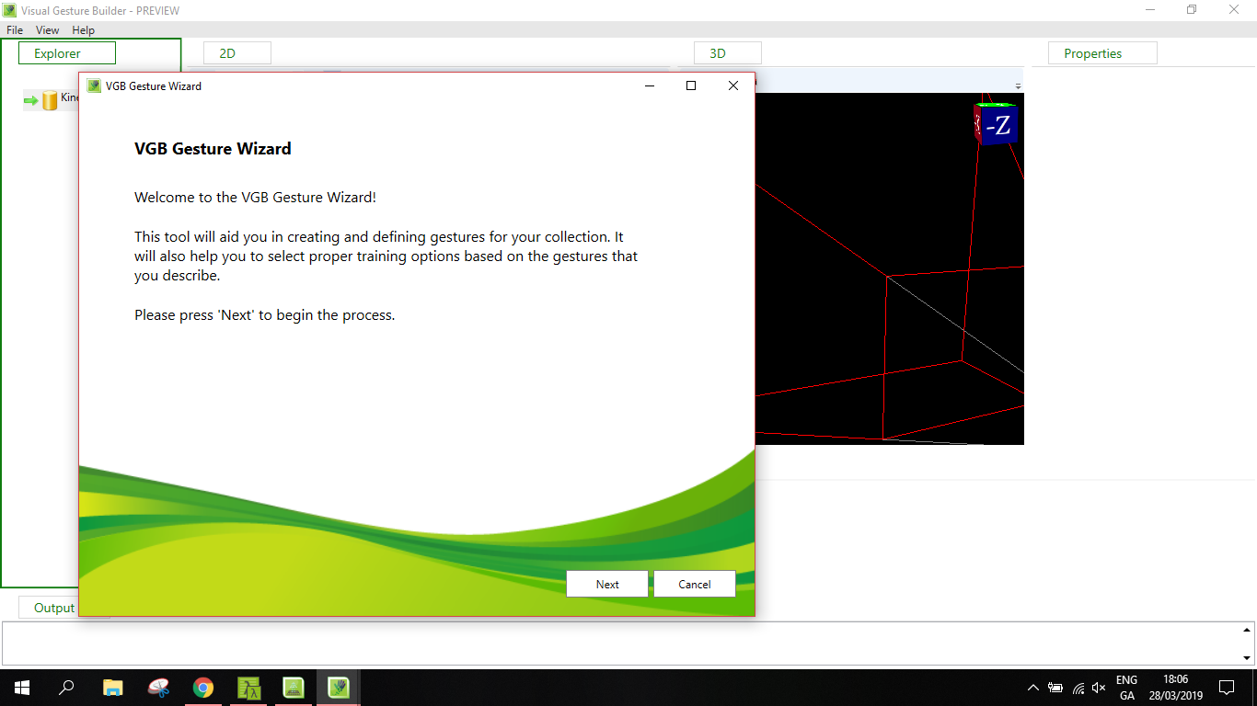
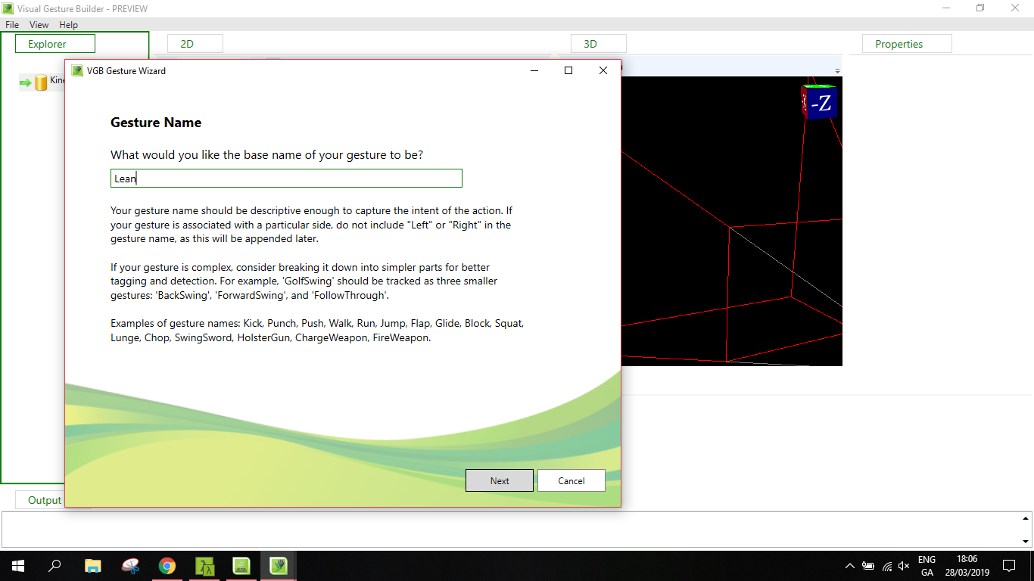
VGB Gesture Wizard

Slide 13
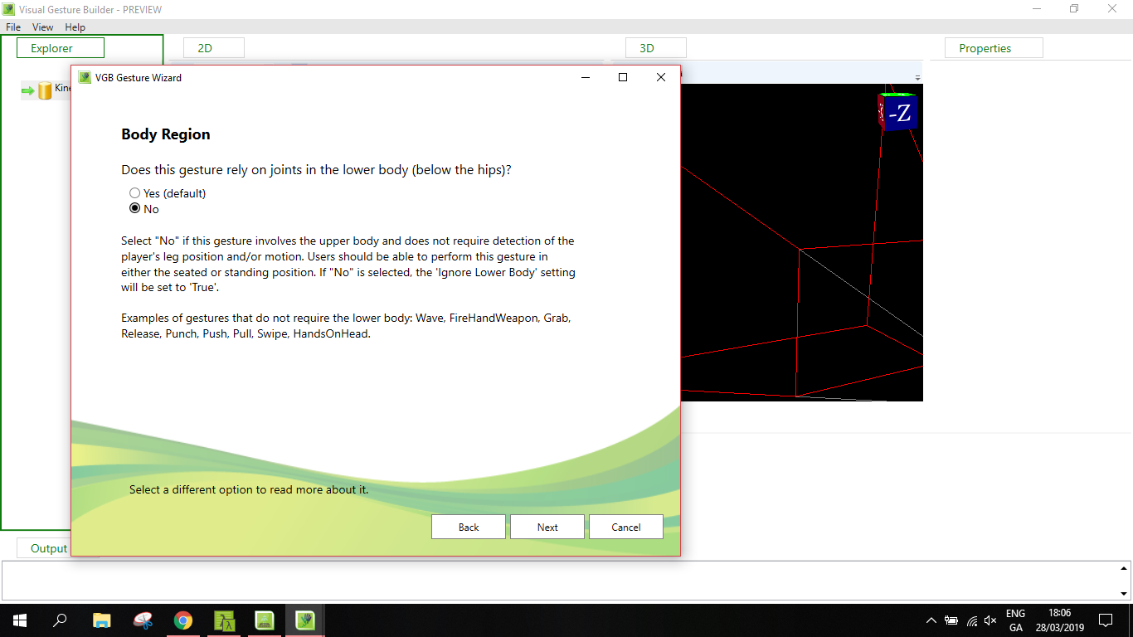

VGB Gesture Wizard

Slide 14


VGB Gesture Wizard

Slide 15


VGB Gesture Wizard

Slide 16
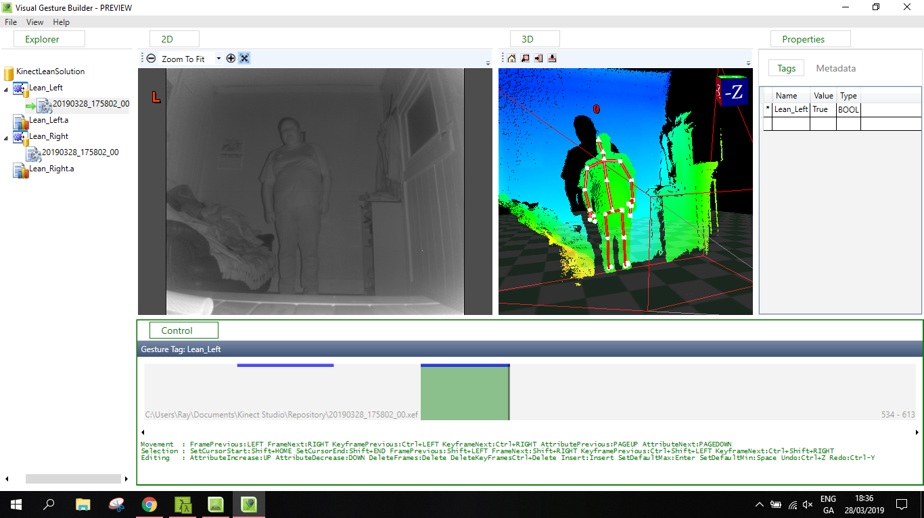
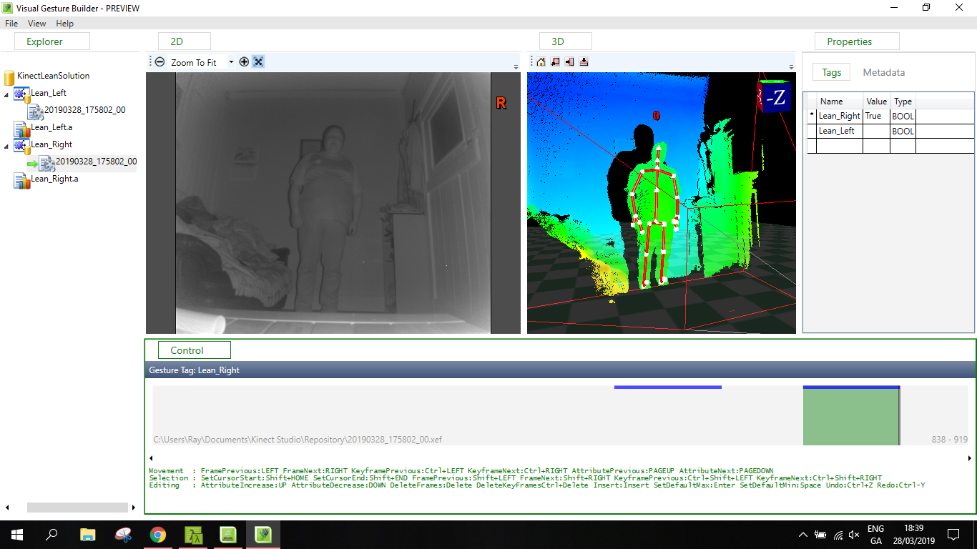
VGB Gesture Wizard

Slide 17
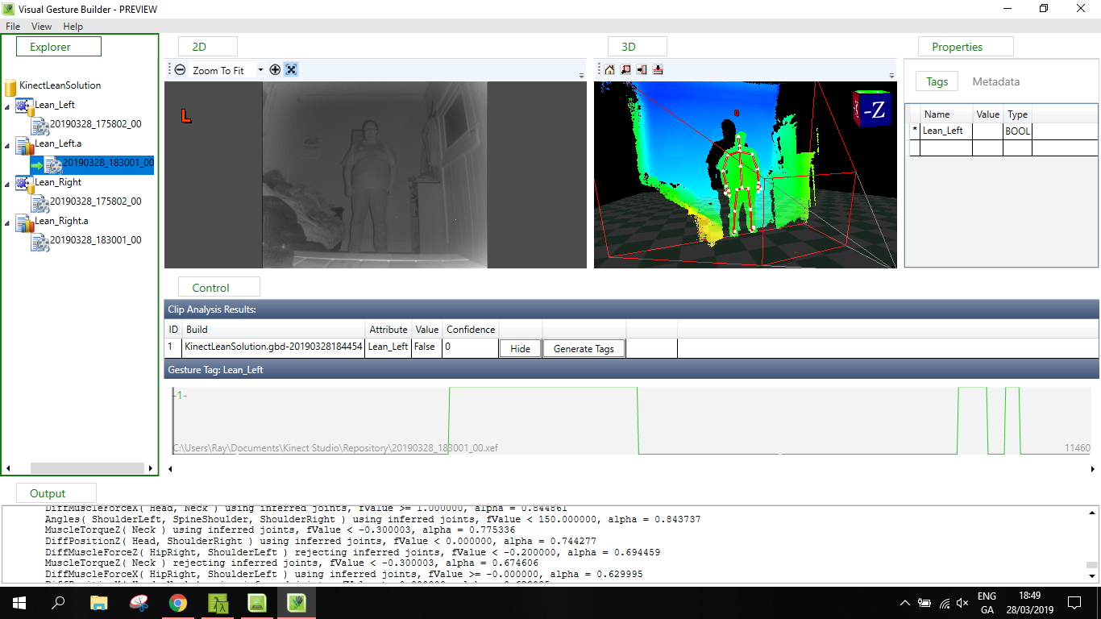
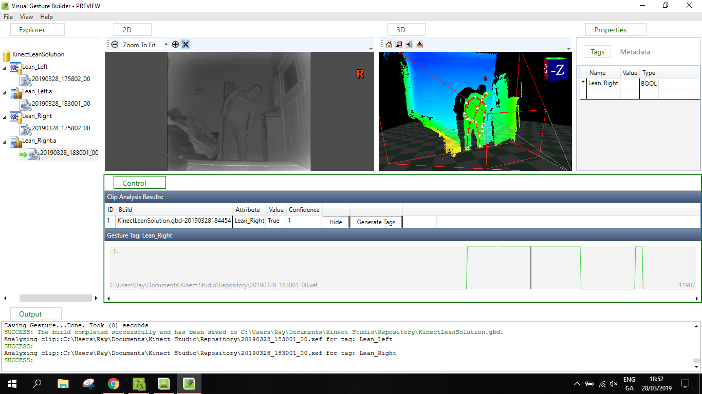
VGB Gesture Wizard

Slide 18
Adding Kinect to Unity
Import Kinect packages
Import the database of gestures that was created
Add a gesture detector script
Add a Kinect Manager
Alter scripts for the ball and paddle

Slide 19
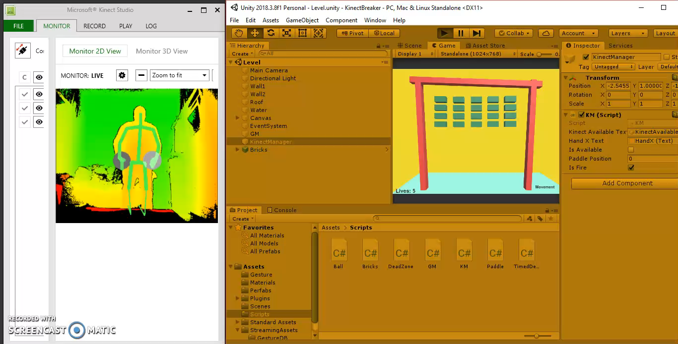
Game Video

Slide 20
Conclusions
Building a gesture database can be very time consuming.
Not a huge amount of examples for Kinect v2
It was an enjoyable project to work on but a more complex project, with more intricate movements i.e. dance revolution , could be very time consuming.

